Slide 1
Review- July 23

Slide 2

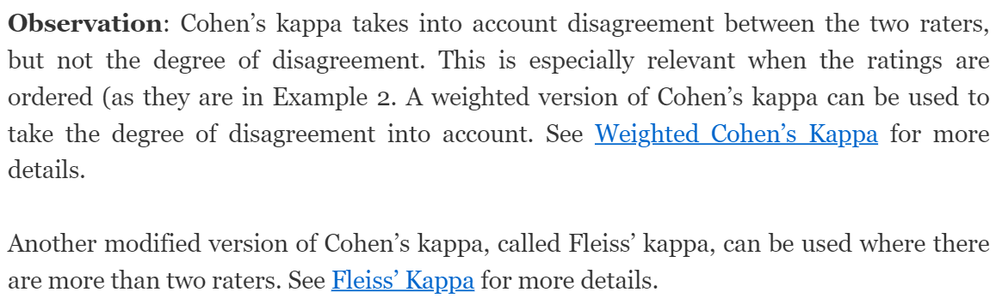
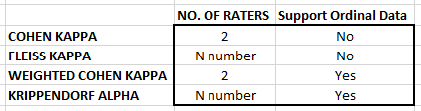
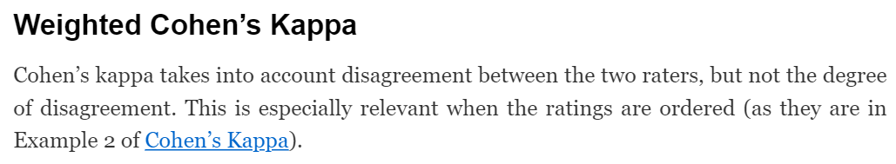

Cohen Kappa
IRR Table
Weighted Cohen Kappa
Fleiss Kappa
Krippendorff’s Alpha

Slide 3


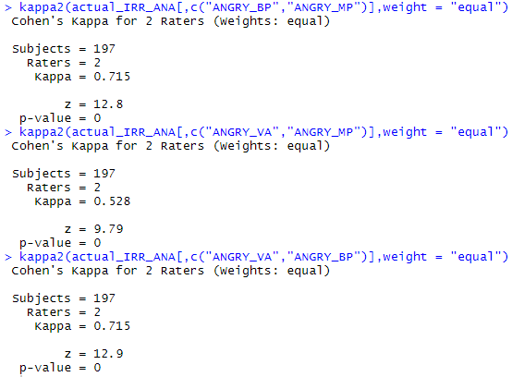
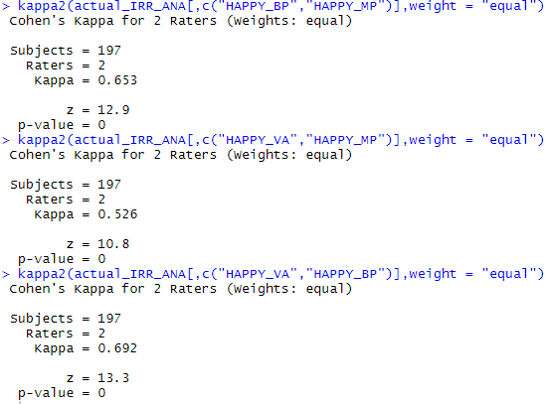
IRR: Weighted Cohen Kappa

Slide 4
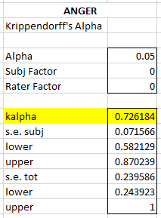
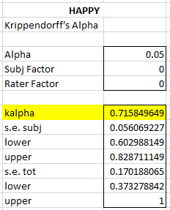
IRR: Krippendorff’s Alpha

Slide 5
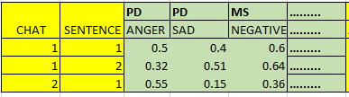
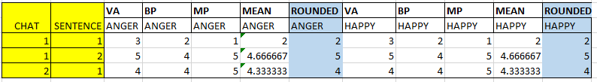
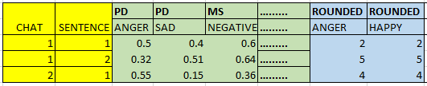
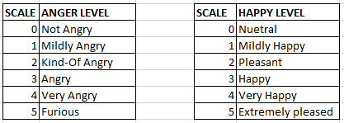
ANGER / HAPPY [1-5] SCALE
APIs Data
BenchMark

Slide 6
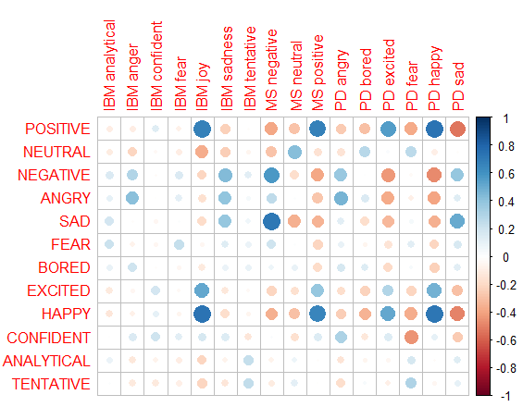
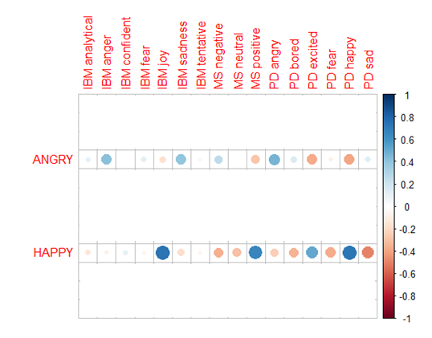
Correlation

Slide 7
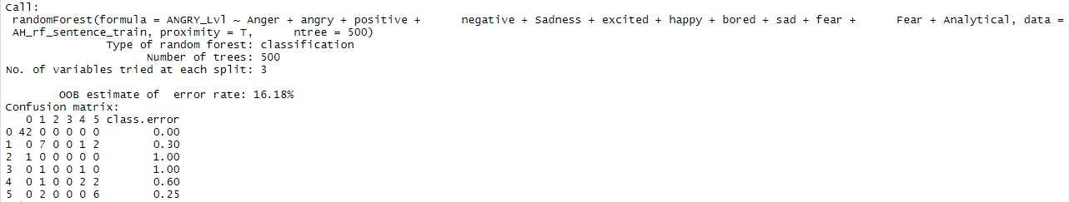
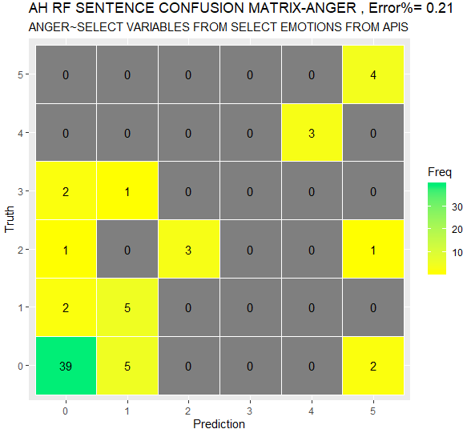
RANDOM FOREST- ANGER
Takeaway's:
We may allow a threshold of +/- 1 for the system
Limited data to train the model on (105 scored sentences). Out of which Approx. 50 are used to train and 50 to test
The predictions are as good as the scores that we receive from the API’s

Slide 8
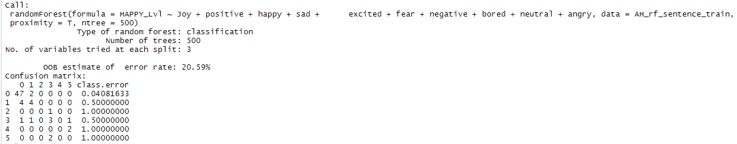
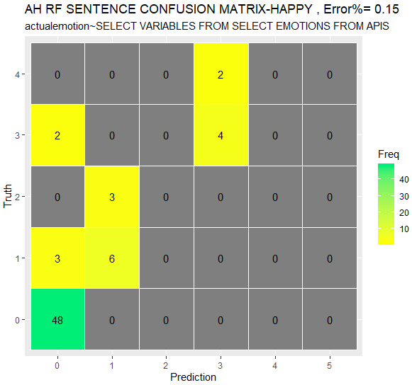
RANDOM FOREST- HAPPY

